Slide 1
Project Final Presentation Pattern Recognition
Md Rifat Ullah
Luddy School of Informatics, Computing, and Engineering
Indiana University Indianapolis

Slide 2
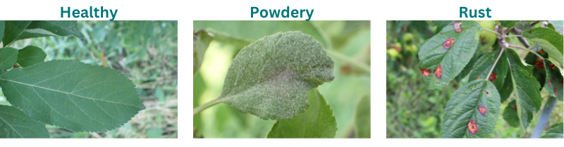
Project Idea
Plant Disease Detection
Image classification tasks using CNN
Notes:
Apple Plant Leaves

Slide 3
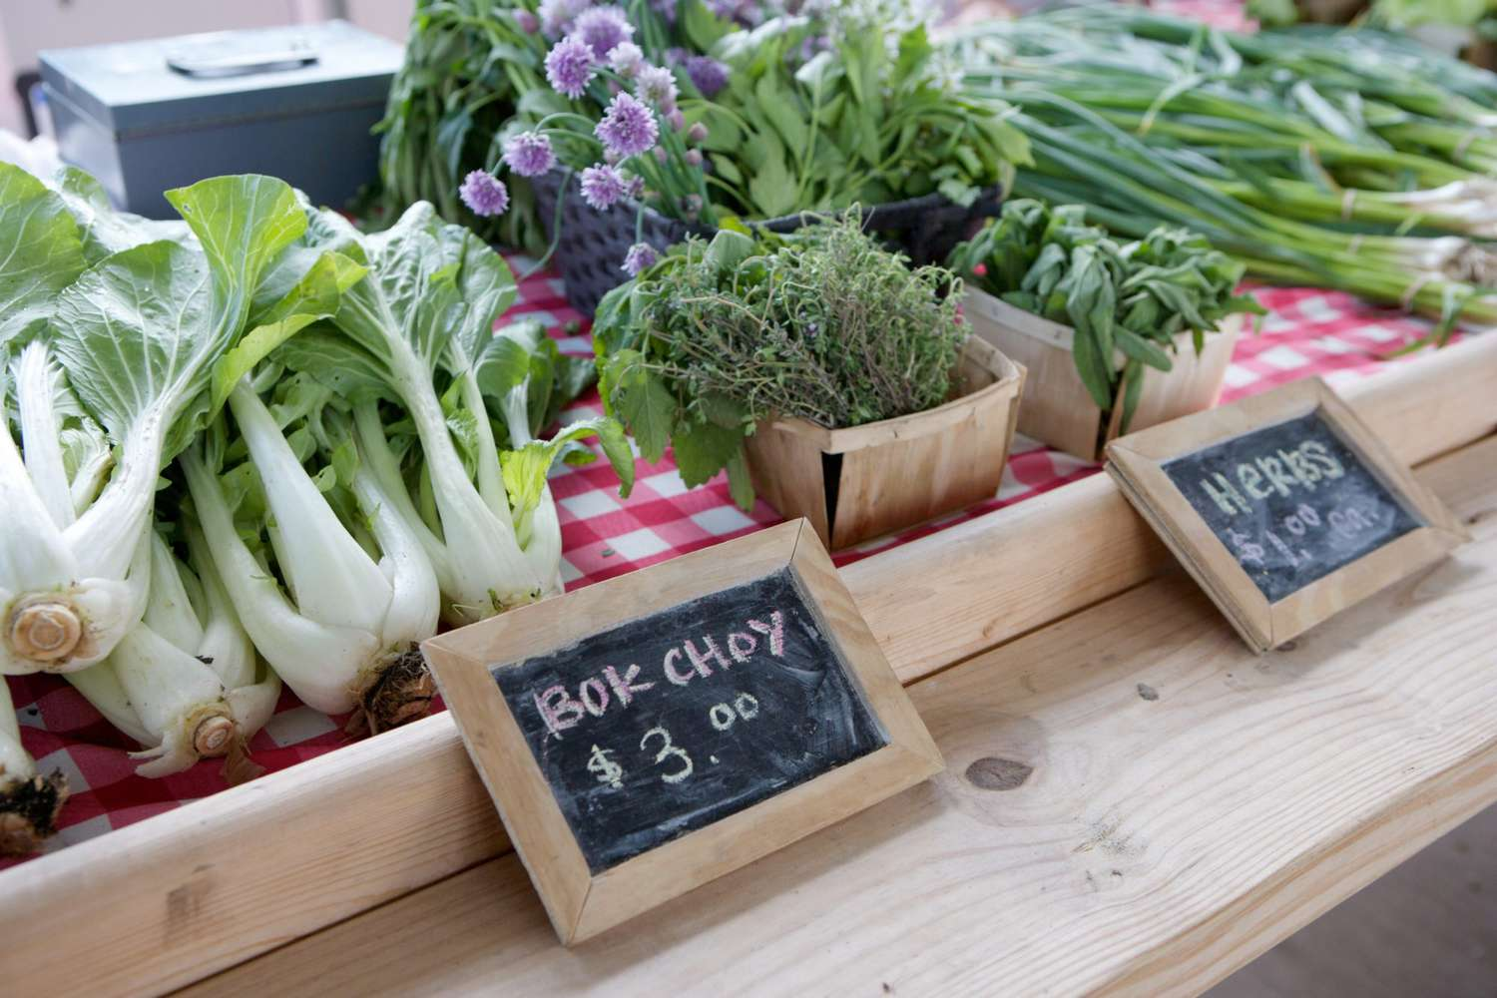
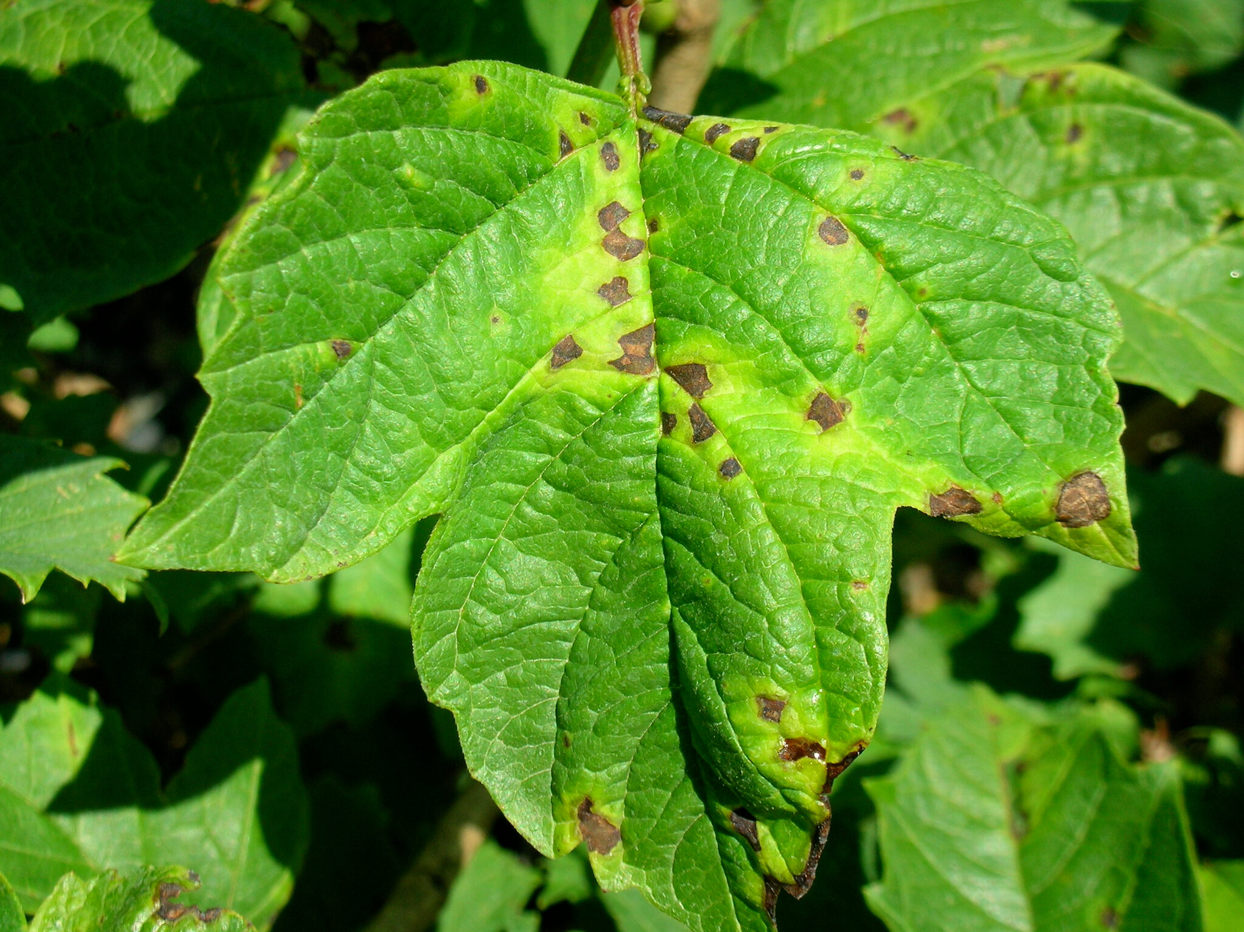
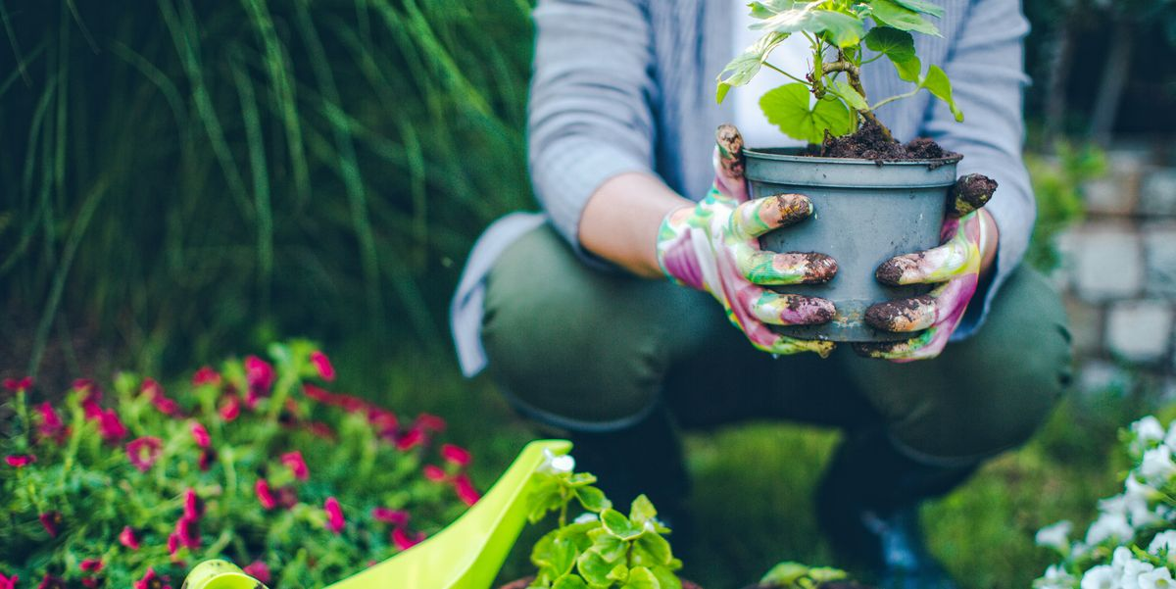
Outcome
To detect a plant, have diseases or not.
So, that human can take necessary steps to prevent the spreading of the disease.
It will contribute and save the people and can make the plants related goods prices lower.

Slide 4

Why do we need it?
To help Farming.
To prevent deforestation.
and it will help the environment to be less damage because of the plants if we can save more and more plant.

Slide 5
Dataset
Collected from Kaggle (Plant disease recognition dataset)
It contains three labels, "Healthy", "Powdery", "Rust" referring to plant conditions.
Total 1532 images divided into train (85%) , test (10%), and validation (5%) sets.
Notes:
https://www.kaggle.com/datasets/rashikrahmanpritom/plant-disease-recognition-dataset/data

Slide 6
Process to Follow
Data Preprocessing: Resizing, Normalizing, Augmentation etc.
Model Design: Designing such as Convolutional and Pooling Layers, Activation function, Output layers and etc.
Model Training: Loss Function, Optimizer, Batch Size and Epochs and validation.
Model Evaluation: Accuracy, Precision, Recall, F-1 Score and Confusion matrix.
Notes:
https://www.kaggle.com/datasets/rashikrahmanpritom/plant-disease-recognition-dataset/data

Slide 7

Process to Follow
Notes:
https://www.kaggle.com/datasets/rashikrahmanpritom/plant-disease-recognition-dataset/data

Slide 8
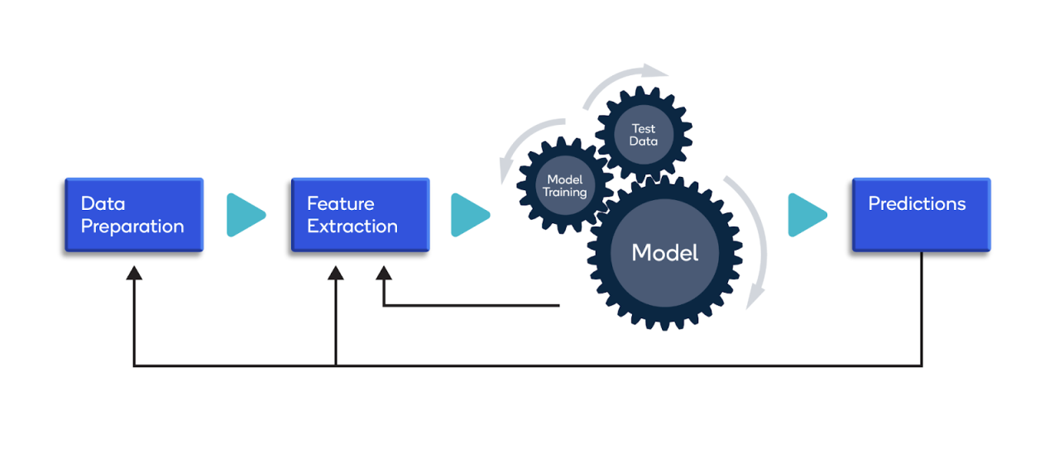
Process to Follow
Notes:
https://www.kaggle.com/datasets/rashikrahmanpritom/plant-disease-recognition-dataset/data

Slide 9
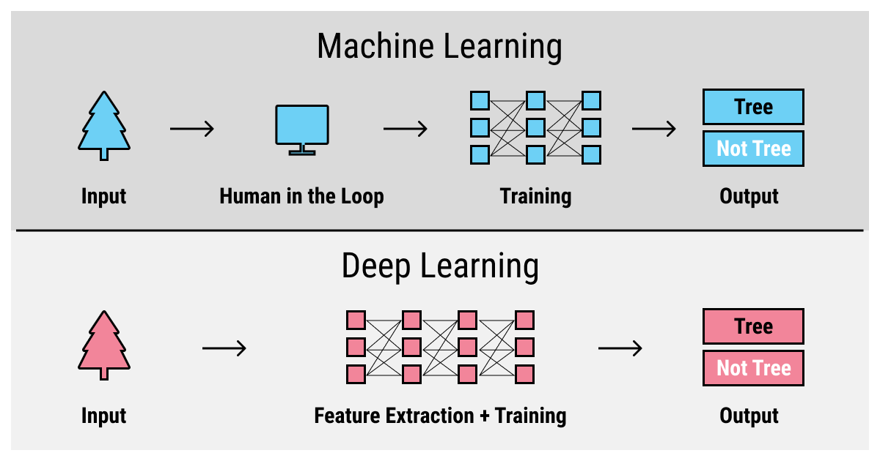
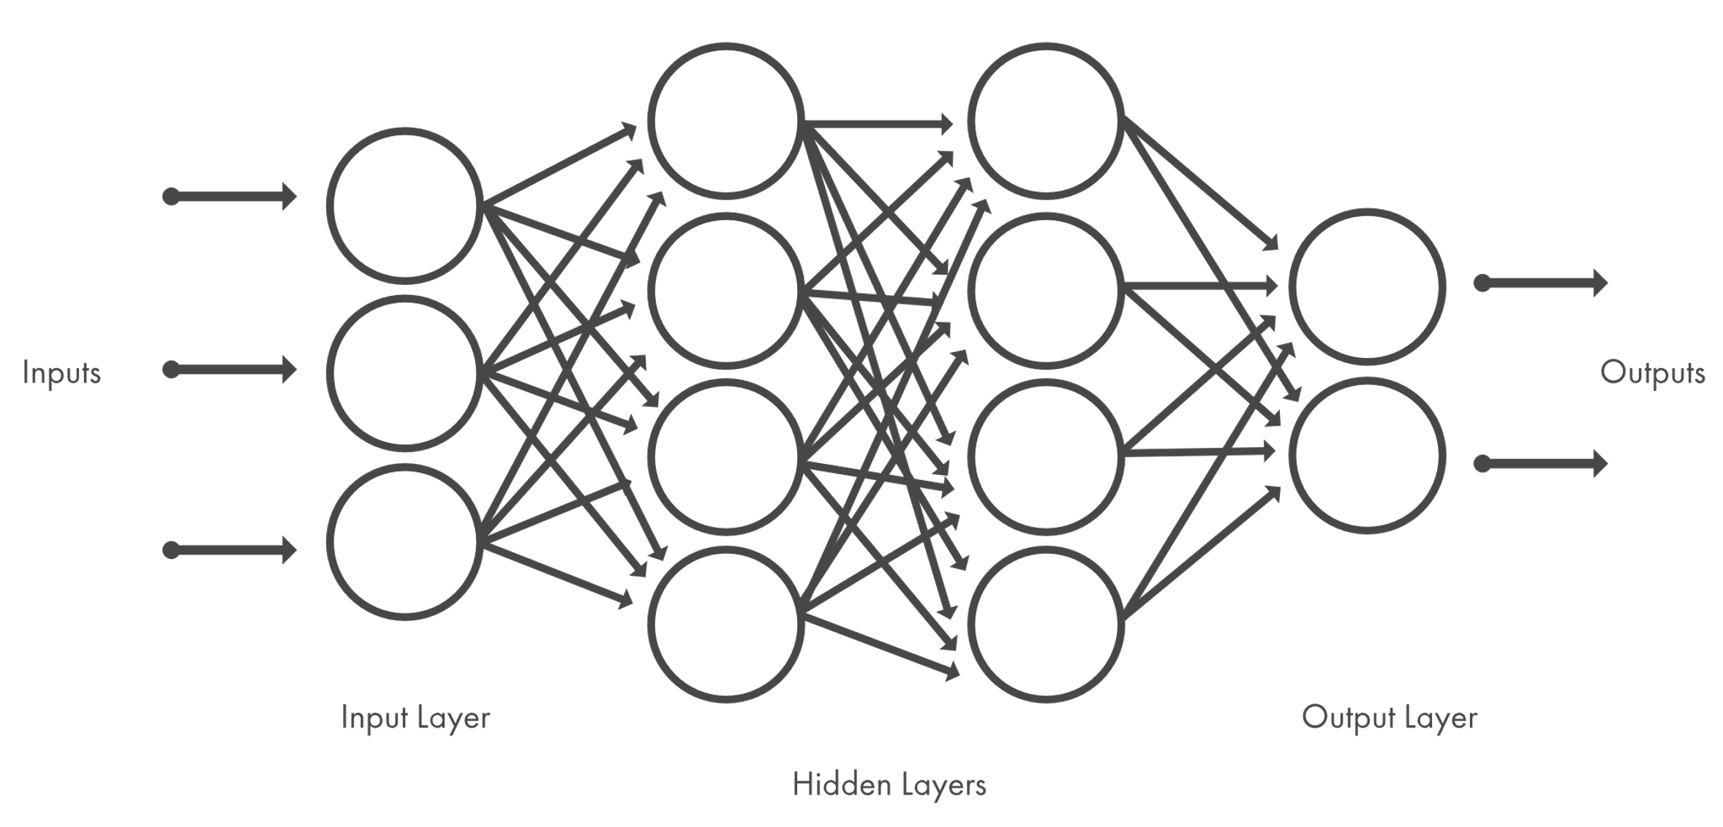
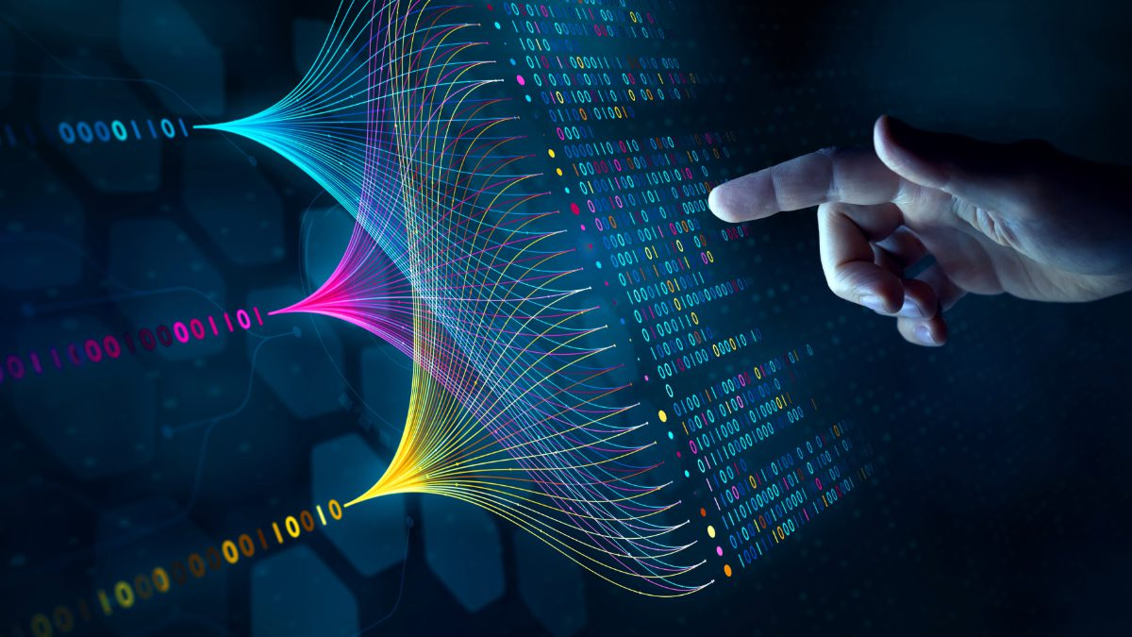
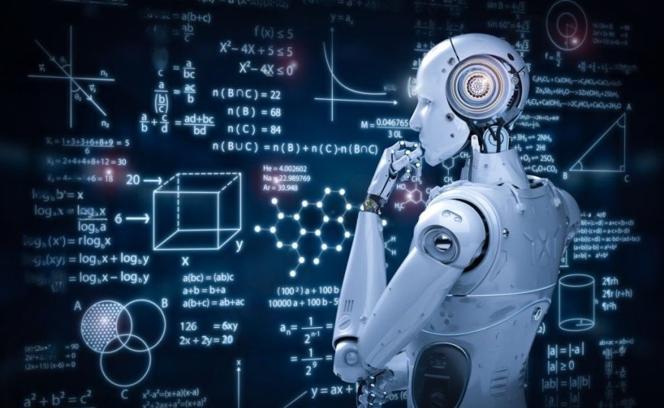
Models
CNN
SVM,
KNN,
RNN.

Slide 10
Model Hyperparameters
CNN:
Batch size for train generator is 32 and for model training is 16, Epoch 25, ReLU and Softmax.
RNN:
Batch size 32, Bidirectional LSTM, optimizer='adam’, loss = 'categorical_crossentropy’ and Epoch 25, ReLU and Softmax.
KNN:
n_neighbors=5, metric='euclidean',
SVM:
Linear Kernel,

Slide 11
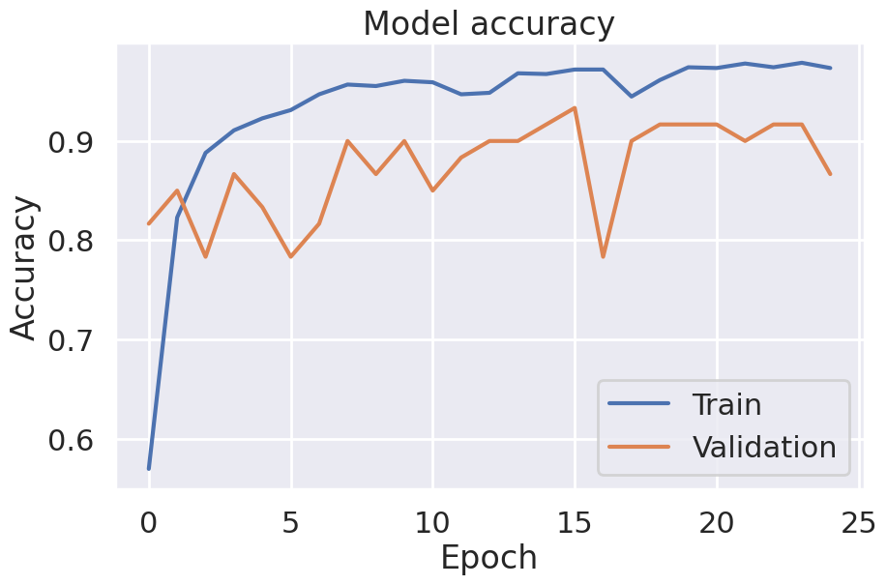
CNN Findings
Test Accuracy is 90.00%
Notes:
Conv2D(32, (3, 3), input_shape=(225, 225, 3), activation='relu'):
Applies 32 filters of size 3x3 to the input image of shape 225x225 with 3 color channels (RGB).
ReLU (Rectified Linear Unit) is used as the activation function, which introduces non-linearity by zeroing out negative values.
MaxPooling2D(pool_size=(2, 2)):
Reduces the spatial dimensions (height and width) of the feature maps by taking the maximum value from a 2x2 region, effectively downsampling the image and making the model more computationally efficient.
Flatten():
Converts the multi-dimensional output from the convolutional and pooling layers into a 1D vector that can be fed into the fully connected layers.
Dense(64, activation='relu'):
A fully connected layer with 64 neurons. It uses ReLU as the activation function to introduce non-linearity and allow the model to learn more complex patterns.
Dense(3, activation='softmax'):
The final output layer with 3 neurons, representing the 3 possible classes. Softmax activation ensures that the output is a probability distribution over the 3 classes, summing to 1, which is useful for multi-class classification problems.

Slide 12
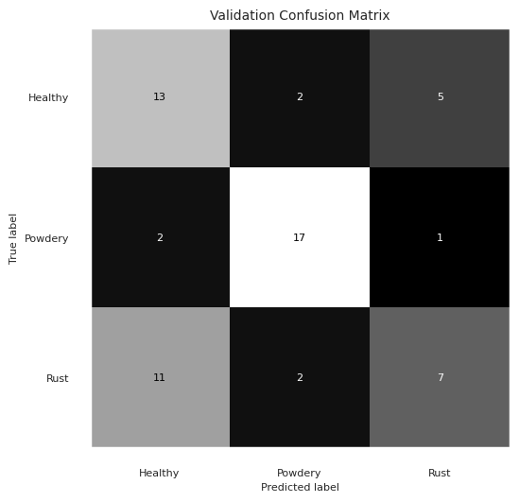
SVM Findings
Test Accuracy 69.33%

Slide 13
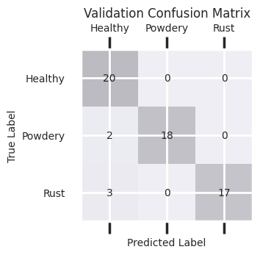
KNN Findings
Test Accuracy 90.00%

Slide 14
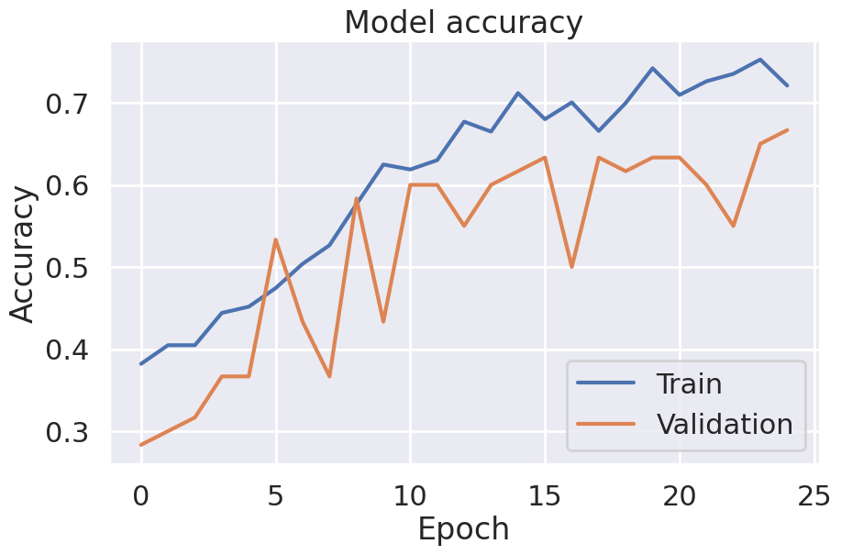
RNN Findings
Test Accuracy is 66.00%

Slide 15
Result Comparison

Slide 16
Result Analysis
ML Algorithms | Training | Testing
CNN | 97% | 90%
RNN | 71% | 66%
SVM | 61.67% | 69.33%
KNN | 91.67% | 90%
Why do SVM and KNN perform well, even compared to CNN/RNN?

Slide 17
Result Analysis
Simpler Dataset or Small sample size of the dataset.
Traditional methods like KNN and SVM can perform surprisingly well. CNNs need more data to generalize properly.
CNN might be overfitting.
Results suggests some overfitting, though not extreme.
KNN is non-parametric.
If image classes are visually distinct and data is well-preprocessed (e.g., resized and normalized), KNN can do really well.
KNN also benefits from data similarity, not learned features.

Slide 18
Result Analysis
SVM shows underfitting but decent generalization.
Low training accuracy (61.67%) but higher test accuracy (69.33%).
May suggest underfitting (model too simple), but also robustness to overfitting.
SVMs work well with linearly separable features, especially with dimensionality reduction or handcrafted features.
RNN IS NOT SUITABLE FOR IMAGE CLASSIFICATION.
RNNs are designed for sequential data (e.g., text, time series).
They don’t learn spatial hierarchies well.
Reshaping images into sequences can break spatial structure → poor performance.
Hence, 71% train / 66% test shows it’s not learning much.

Slide 19
Limitations
The dataset is not large, so that the model might not give us optimize results.
Limitations of resources to run the training.
The training was too long time to trained the model.

Slide 20
References
[1] https://www.kaggle.com/datasets/rashikrahmanpritom/plant-disease-recognition-dataset/discussion/360986
[2]

Slide 21
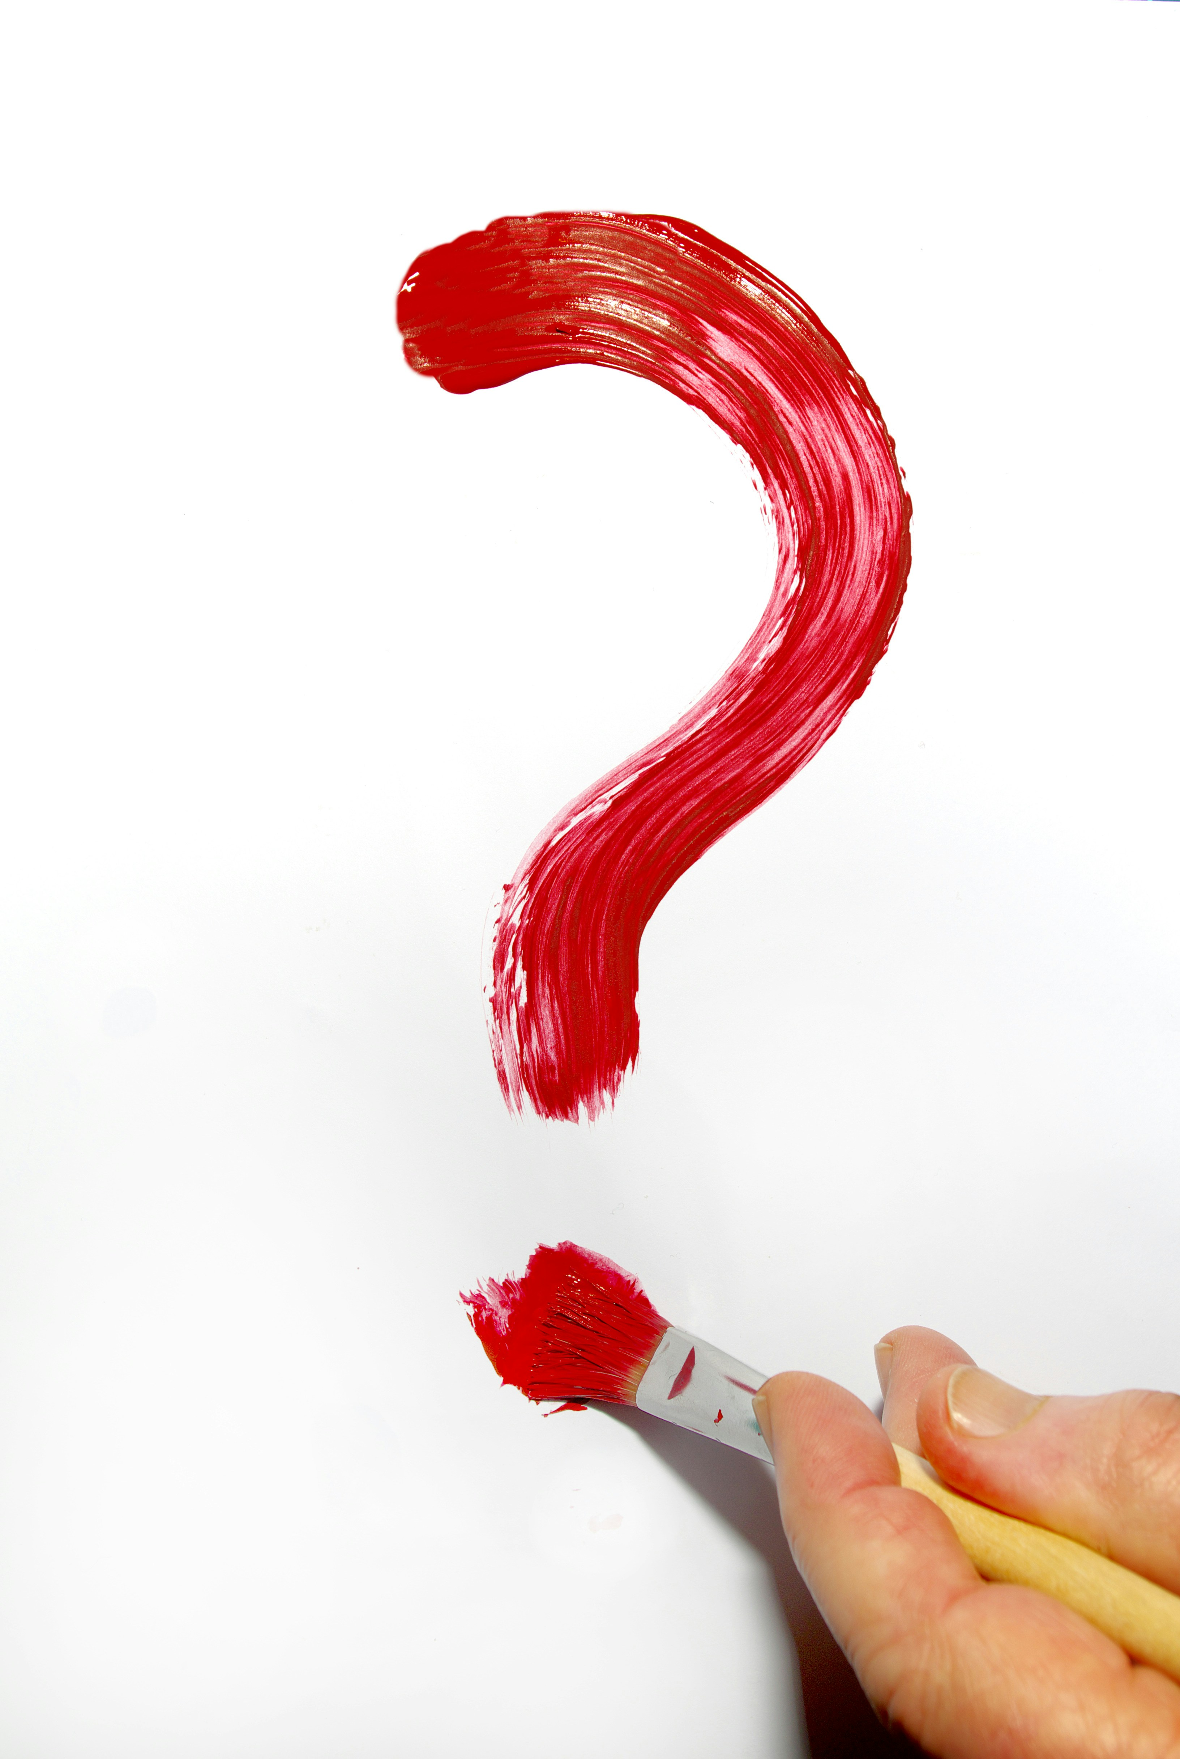
Thanks!

